Slide 1
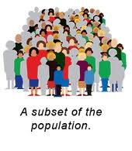
9. Determining How to Select the Sample
Frank Lin

Slide 2
To do list:
Mid-term exam
PA5 (complete all data collections)
Agenda:
CE6
Sample selection lecture

Slide 3
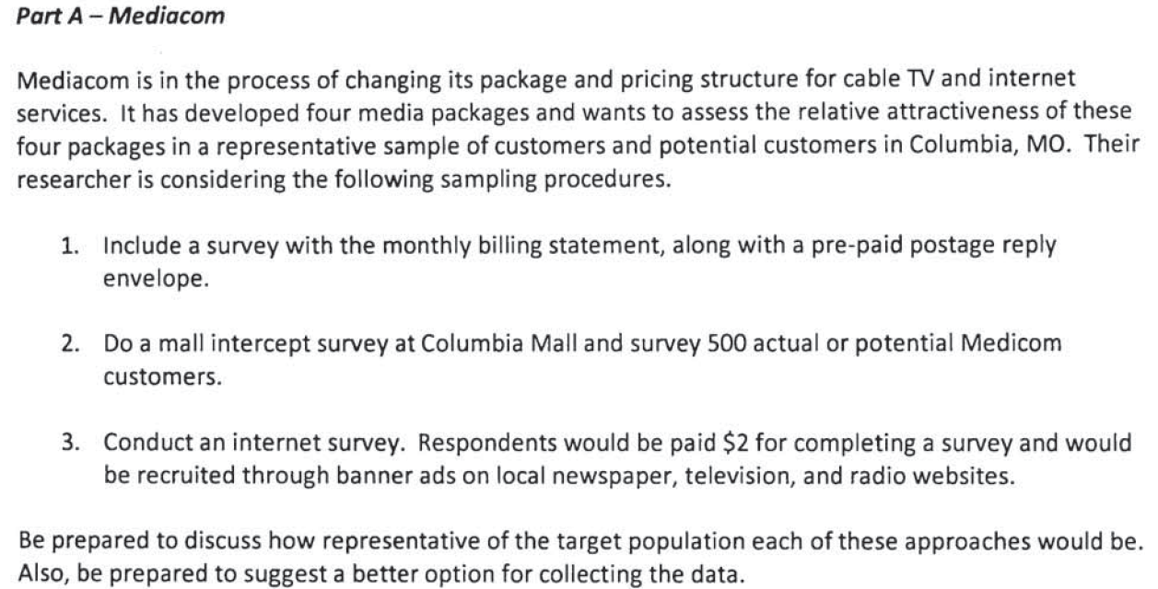
CE6

Slide 4
Some Basic Concepts in Sampling
Population: the entire group under study as defined by research objectives
specific terms, such as “heads of households located in zip code 65201-65215 who are responsible for making the pest control decision.”
Sample: a subset of the population that should represent the entire group

Slide 5
Some Basic Concepts in Sampling
Sample unit: the basic level of investigation
Census: an accounting of the complete population
Sampling error: any error in a survey that occurs because a sample is used (sample selecting method, sample size)
Sample frame: a master list of the entire population

Slide 6
Some Basic Concepts in Sampling
Sample frame error: the degree to which the sample frame fails to account for all of the population…a telephone book listing does not contain unlisted numbers
Target population: Single-parent households in Chicago
Sampling frame:
List provided by a commercial vendor

Slide 7
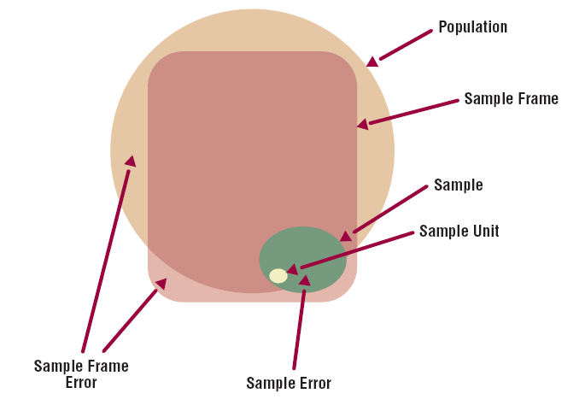
Some Basic Concepts in Sampling

Slide 8
Why we Take a Sample
Practical considerations such as cost and population size
Inability of researcher to analyze huge amounts of data generated by census (esp. if “hard-copy” questionnaires are used)

Slide 9
Two Basic Sampling Methods
Probability Sampling
Non-Probability Sampling
Difference: members of the population have a known vs. unknown chance of being selected into the sample

Slide 10
Probability Sampling Methods
Simple Random Sampling
Systematic Sampling
Cluster Sampling
Stratified Sampling

Slide 11
Probability Sampling Methods
Simple random sampling: the probability of being selected into the sample is “known” and equal for all members of the population
E.g., Blind Draw Method
Random Numbers Method (Excel: “=rand()”)
Probability of selection = sample size/population size

Slide 12
Probability Sampling Methods
Example:
population size = 60,000 (Columbia residents who are over the age of 15)
select 3000 people to answer the survey
What is the probability of selection for each person in the population?
Disadvantage: Need complete listing/accounting of the population

Slide 13
Probability Sampling Methods
Systematic Sampling: way to select a random sample from a directory or list that is much more efficient (use less effort) than simple random sampling
Skip interval=population list size/sample size

Slide 14

Probability Sampling Methods
Example:
Tennis magazine drew a systematic sample from its 1,400,000 subscribers for a mail survey. The sampling interval was 1,000. A starting point was selected at random
Disadvantage: Listing Error

Slide 15
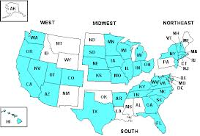
Probability Sampling Methods
Cluster Sampling: method in which the population is divided into groups, any of which can be considered a representative sample
Area sampling – subdivide the population to be surveyed into geographic areas, such as census tracts, cities, neighborhoods
Disadvantage: Non-homogeneous clusters

Slide 16
Probability Sampling Methods - iclicker
Stratified Sampling: method in which the population is separated into different subgroups/strata and a sample is taken from each stratum
Why do we need to do this
Example: “To what extent do you value your college degree?”
which year of students (freshman, sophomore, junior, senior) would value more?
which year of students would have more diverse opinion?

Slide 17
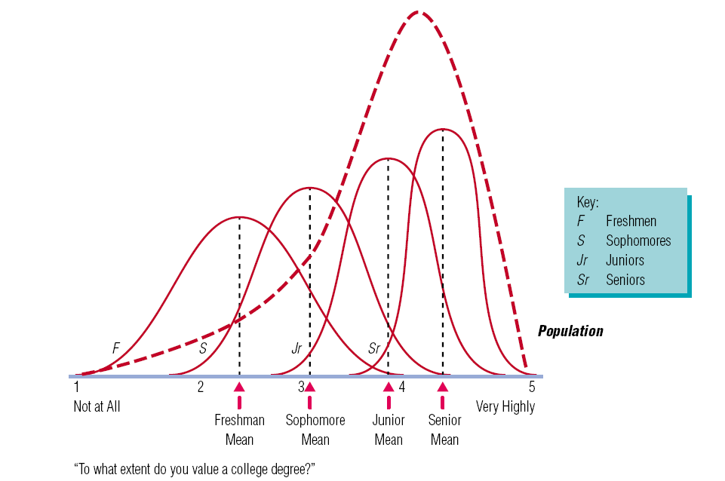
Probability Sampling Methods
Note that we would expect this question to be answered differently depending on student classification. Not only are the means different, variance is less as classification goes up…Seniors tend to agree more than Freshmen!

Slide 18
Probability Sampling Methods
Stratified Sampling:
Allocate more sample size to strata with more variance and less sample size to strata with less variance. Thus, for the same sample size, more precision is achieved.
Disadvantage: Disproportionate sampling can occur. Seniors would be sampled LESS than their proportionate share of the population and freshmen would be sampled MORE. More on this in next chapter (sample size)

Slide 19
Non-Probability Sampling Methods
With nonprobability sampling methods selection is not based on fairness, equity, or equal chance
Convenience sampling
Purposive Sampling
Referral sampling
Quota Sampling

Slide 20
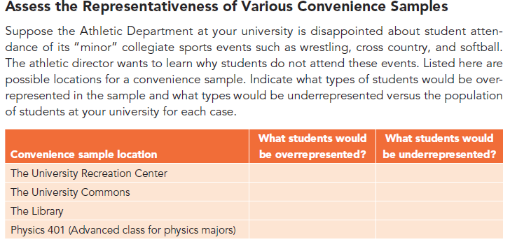
Non-Probability Sampling Methods
Convenience sampling: samples drawn at the convenience of the interviewer

Slide 21
Non-Probability Sampling Methods
Purposive sampling: Personal judgment or that of some other knowledgeable person
Subjectivity and convenience
Referral sampling: samples which require respondents to provide the names of additional respondents
Low variance observed
Quota Sampling: samples are based on characteristics such as demographics or product use.
Size of quota often decided by researchers belief
Often used with convenience sampling

Slide 22
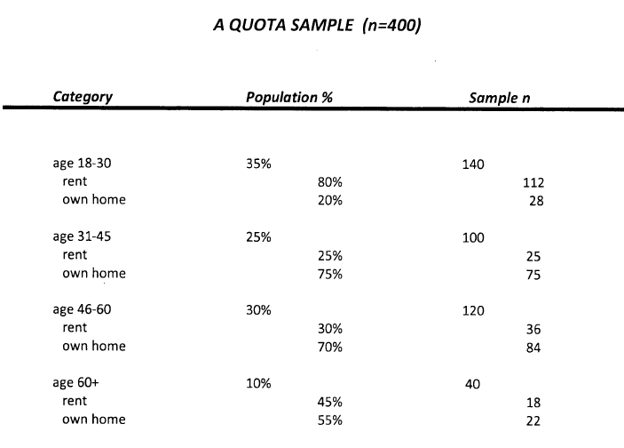
140 = 400*.35%
112= 140*0.8
112= 140*0.2
Your turn. Pause the screen to calculate
Total = 100,000
people
Total = 400
people

Slide 23
Total = 100,000
people
Total = 400
people

Slide 24
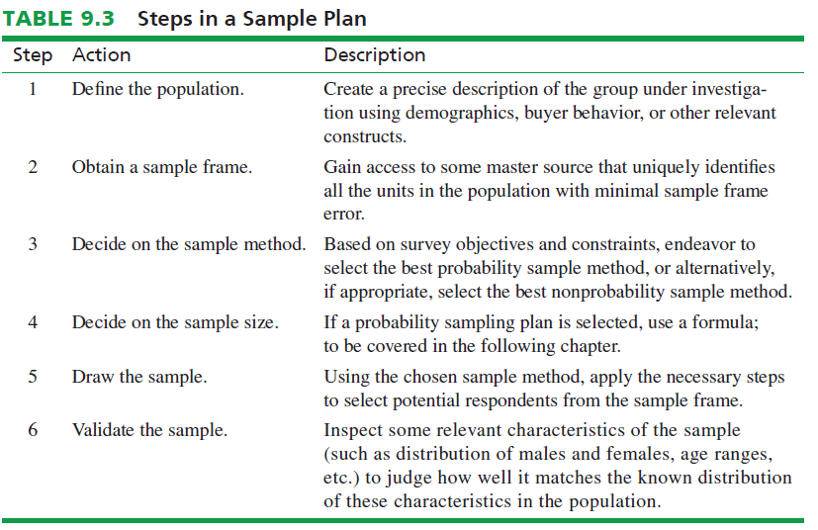

Slide 25
iClicker - What kind of sampling method here?
There is only one street into and out of the subdivision. The president is thinking of paying his teenage daughter to stand at the stop light at the entrance to Peaceful Valley next week between the hours of 7:00 and 8:30 a.m. to hand out questionnaires to exiting drivers while they wait for the red light to change. The handouts would include addressed, postage-paid envelopes for returns.
Identify what sample method the president would be using, list its pros and cons, and indicate how representative a sample would result. If not representative, how would you make it more representative?
Notes:
This is a convenience sample, using the high traffic location where cars stop for the red light. Pros: quick and convenient for the researcher. Cons: some population members will not be sampled as they may not commute at these times, may work at home, might be sick that week, etc. It would only be representative of those who commute to work at those times on those days.

Slide 26
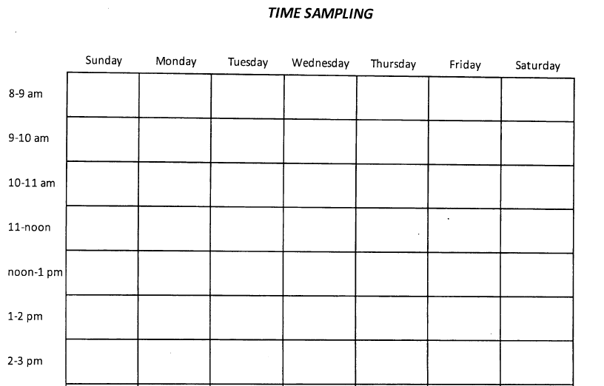
Speaker circle
Speaker circle
Tiger Plaza
Rec center
Tiger Plaza
Rec center

Slide 27
Recap
Population vs. Sample
Sampling method
Probability sampling
Non-probability sampling
How to make the non-probability sampling more representative
Quota sampling
Time and location sampling grid

